Slide 1

Customer’s transaction analysis

Slide 2
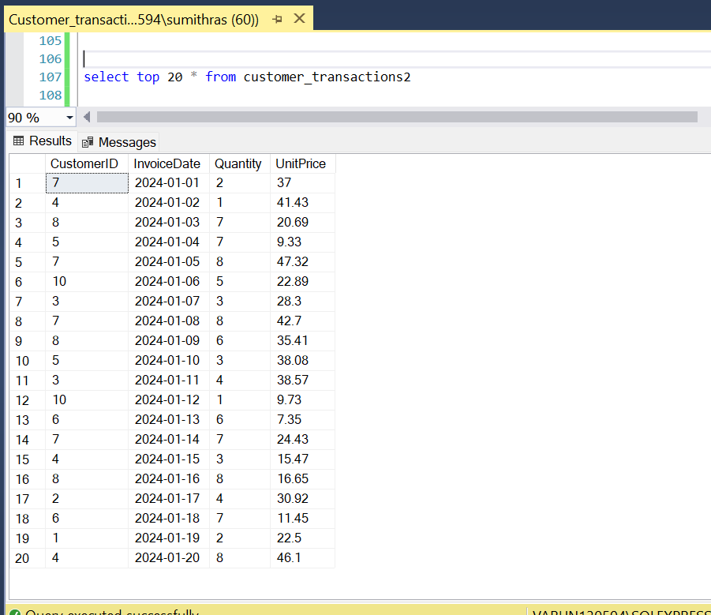
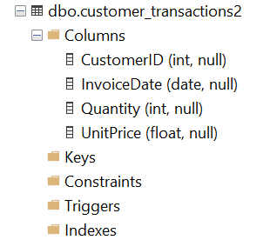
A quick look at the dataset
Table Schema & Columns Cardinality

Slide 3
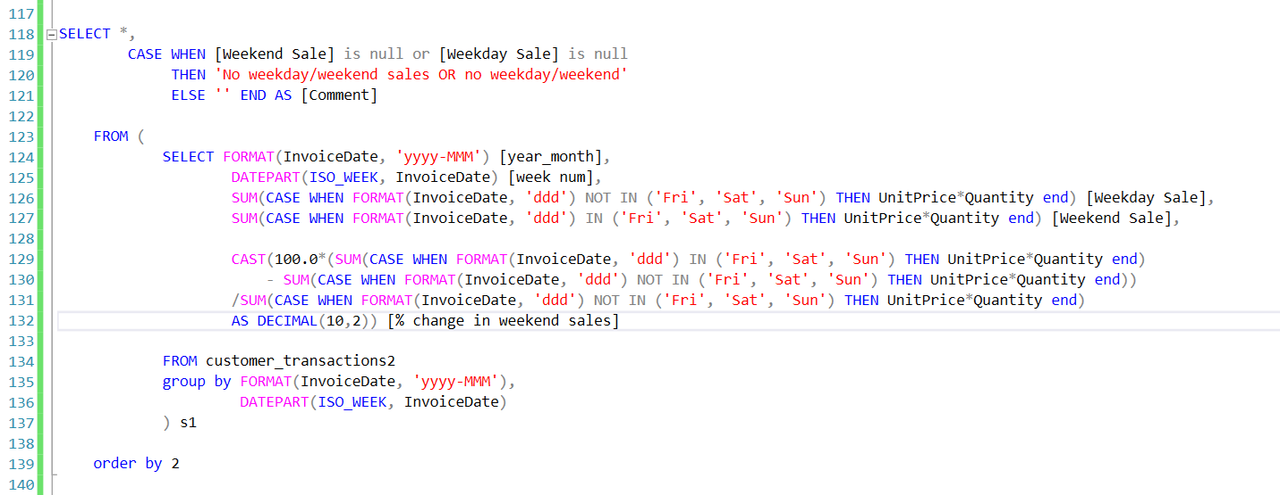
Q1. When is the sales the most, i.e. is on weekdays or weekends? Also, compare weekday sales to weekend sales for each week of the month.
Business would like to consider Friday, Saturday and Sunday as weekends and rest of the days as weekdays

Slide 4
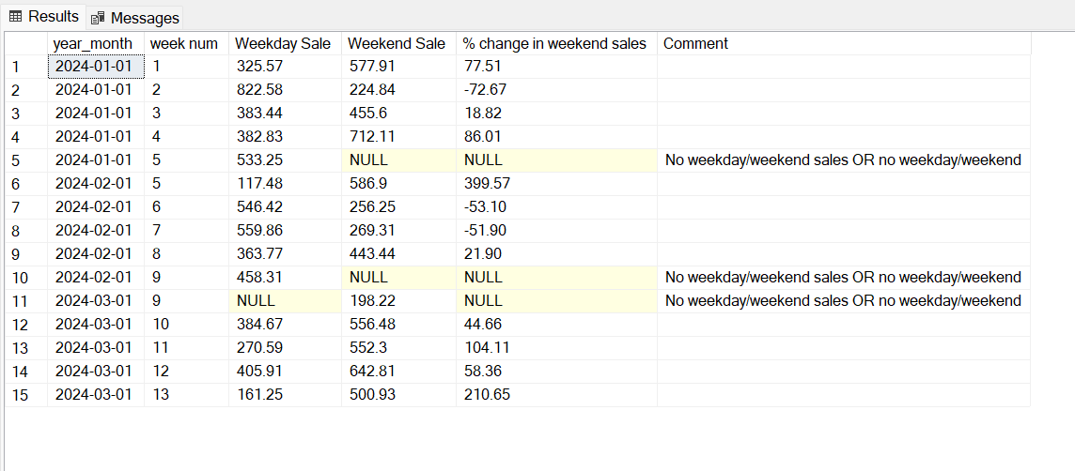
Query’s Result set
Recommendation to BU: Weekend sales in general is significantly more compared to weekday sales, BU can think of offering some discount on weekend sales to capitalize more on this.

Slide 5
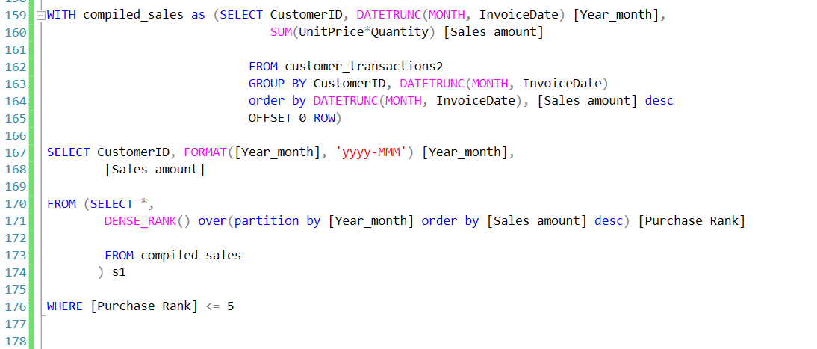
Q2. Identify the top 5 customers for each month who have brought most sales to the store

Slide 6
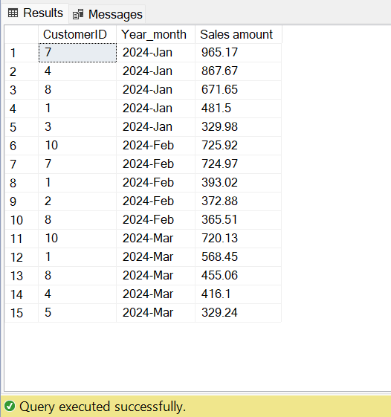
Query’s Result set
Recommendation to BU:
Customers with CustomerID
1, 8, 10 have been consistently purchasing from the store and are in top customers list from last 2 months also, contributing to a significant margin of monthly sales.
These customers can be included for additional discount to capitalize on revenue generation should BU decide to roll out one.

Slide 7
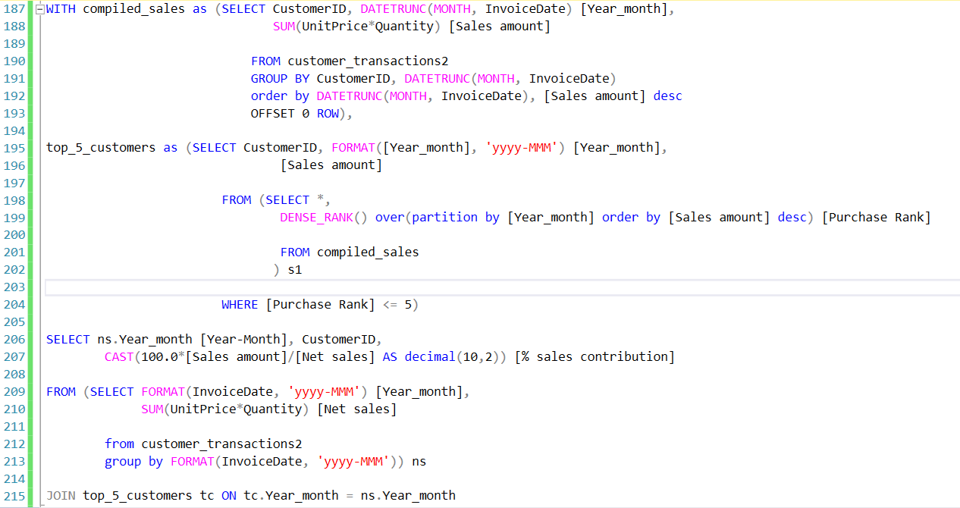
Q3. From the previous finding, determine how much to the total sales have the top 5 customers contributed each month?

Slide 8
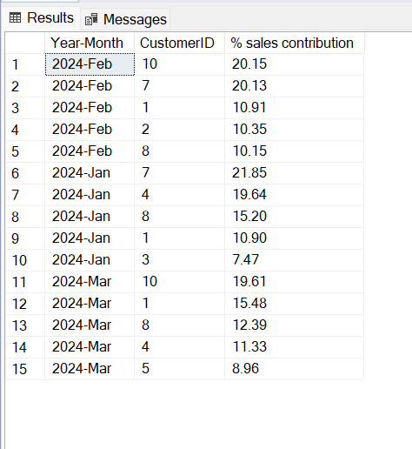
Query’s Result set
Recommendation to BU:
We can roughly say that top 5 Customers are contributing to 65% to 75% of the total sales monthly.
Given the significant share of top 5 customers, a targeted approach can be taken to encourage customers to purchase more.

Slide 9
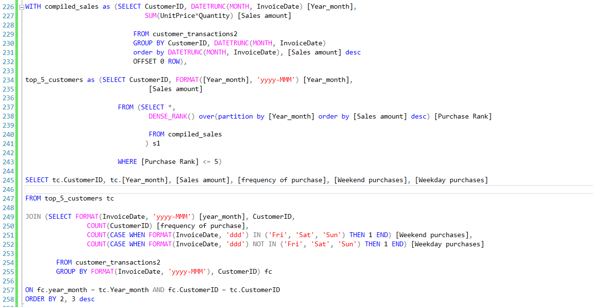
Q4. BU wants to know if top 5 customers are making any sort of bulk transactions or if their purchase is evenly spread over a month. Also, how does their purchase compare over a weekend to their weekday purchase?

Slide 10
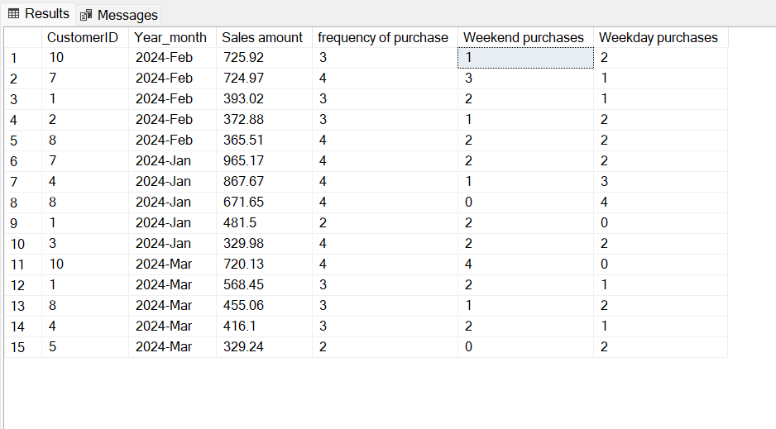
Query’s Result set
Recommendation to BU: The purchase pattern seems to be pointing at an inclined sales during the weekends for top 5 customers, more or less solidifying our finding on Q1. Hence rolling out a discount campaign on a weekend in general makes sense.

Slide 11
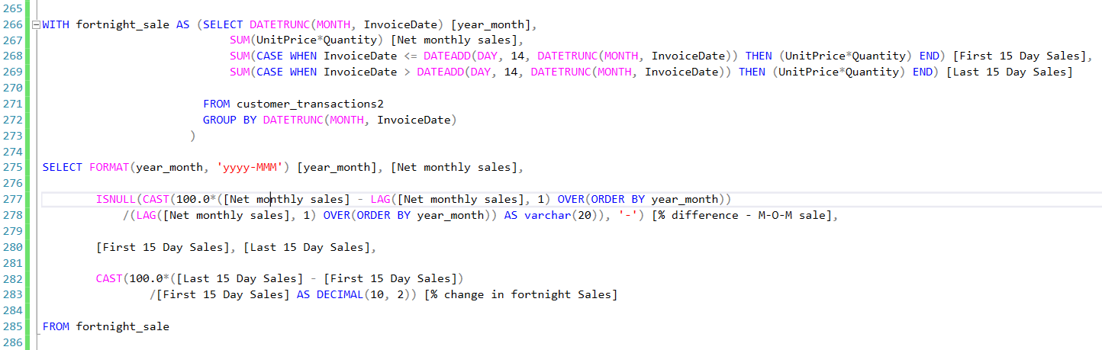
Q5. Derive a query to compare M-O-M sales and also compare sales for the first 15 days (from 1st to 15th) to last 15 days (from 16th to EOM) for each month

Slide 12
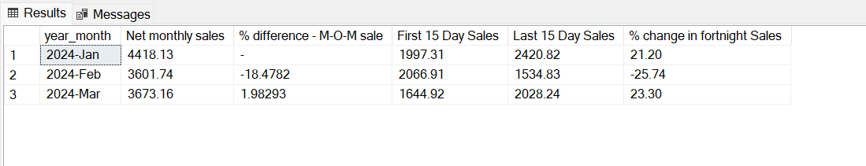
Query’s Result set
Recommendation to BU:
Observation: The sales after January has dropped by 18.5% and has increased slightly in subsequent months, tracking of further months is required to know any seasonality on this.
Interestingly, the average fortnight sales for the last 15 days of the month seems to be more compared to first 15 days, this may need more probing as what might be the factors to it, before any conclusions can be made.

Slide 13


It’s now the closure of business hours, thank for your time in looking into my business 😉
As a token of my gratitude, feel free to utilize this PPt and query files into your portfolio. Link is in the post.

